Slide 1

Fermi-Dirac Energy Distribution
EP - 301 Semiconductor Devices
Submitted by - Aditya Singh 2K19/EP/005
Arkajyoti Chakraborty 2K19/EP/022

Slide 2
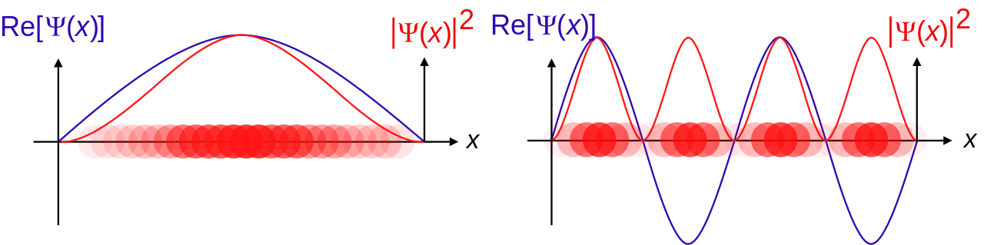
Electrons and holes play an essential role in the transfer of electricity in semiconductors. These particles are arranged at a different energy level in a semiconductor. The movement of electrons from one energy level to other generates electricity. An electron inside the metal should possess an energy level that is at least greater than the surface barrier energy to escape to a higher energy level.
Distribution functions are nothing but the probability density functions used to describe the probability with which a particular particle can occupy a particular energy level.

Slide 3
Introduction
When we speak of Fermi-Dirac distribution function, we are particularly interested in knowing the chance by which we can find a fermion in a particular energy state of an atom. Here, by fermions, we mean the electrons of an atom which are the particles with ½ spin, bound to Pauli exclusion principle.
There were many theses proposed and accepted explaining the characteristics and behavior of electrons. But some behavior of electron such as the independence of emission current on temperature etc… still remained a mystery. Then a breakthrough statistics, Fermi Dirac Statistics, published by Enrico Fermi and Paul Dirac in 1926 helped to solve these puzzles.

Slide 4
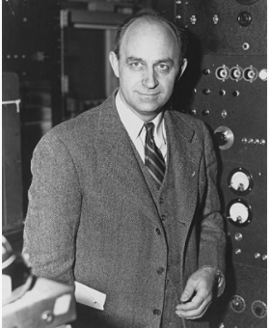

The Statistical Model
Fermi-Dirac Statistics is describes the distribution of the particles over the energy states in system consisting of many identical particles.
The statistics is named after Dr. Enrico Fermi and Dr. Paul Dirac, and it’s considered as one of the great models in showing the distribution of energy of the particles in the system.

Slide 5
Fermi-Dirac Distribution
Now let us look at the energy distribution of electrons in various types of semiconductor. The value of Fermi energy varies for different materials. Based on the energy possessed by electrons in a semiconductor, conduction band contains excited electrons, valence band contains holes.
Fermi level is the energy state which has probability ½ of being occupied by an electron. In simple terms, it is the maximum energy level that an electron can have at 0k and the probability of finding the electron above this level at absolute temperature is 0. At absolute zero temperature, half of the Fermi level will be filled with electrons.

Slide 6
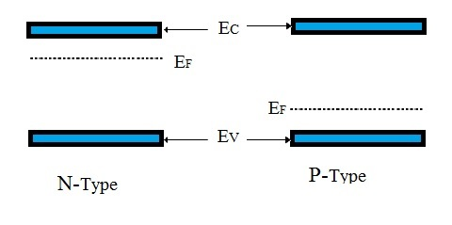
In energy band diagram of semiconductor, Fermi level lies in the middle of conduction and valence band for an intrinsic semiconductor.
For extrinsic semiconductor, Fermi level lies near valency band in P-type semiconductor and for N-type semiconductor, it lies near to the conduction band.
Fermi energy level is denoted by EF, the conduction band is denoted as EC and valence band is denoted as EV.

Slide 7

Fermi Dirac Distribution Function
The probability that the available energy state ‘E’ will be occupied by an electron at absolute temperature T under conditions of thermal equilibrium is given by the Fermi-Dirac function. From quantum physics, the Fermi-Dirac Distribution Expression is
Where k is the Boltzmann constant in 0 K, T is the temperature in 0 K and E_{F} is the Fermi energy level in eV.k = 1.38X10-23 J/K.
Fermi-Dirac distribution only gives the probability of occupancy of the state at a given energy level but doesn’t provide any information about the number of states available at that energy level.

Slide 8
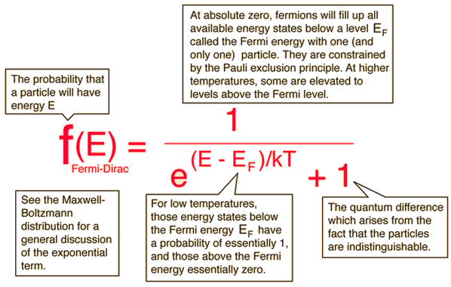

Slide 9
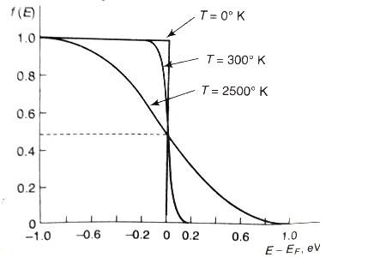
Fermi-Dirac Distribution & Energy Band Diagram

Slide 10
The previous plot shows the behavior of Fermi level at various temperature ranges T= 0 K, T= 300 K, T= 2500 K. At T=0 K, the curve has step-like characteristics.
At T = 0K, the total number of energy levels occupied by electrons can be known by using the Fermi-Dirac Function.
For a given energy level E > E_{F}, the exponential term in the Fermi-Dirac function becomes 0, which means that the probability of finding the occupied energy level of energy greater than E_{F} is zero.
For temperature greater than absolute temperature and E = E_{F}, then independent of the value of temperature.
For temperature greater than absolute temperature and E < E_{F}, then the exponential will be negative. f(E) starts at 0.5 and tends to increase towards 1 as E decreases.

Slide 11

Boltzmann Approximation
By using Maxwell– Boltzmann approximation the above equation is reduced to
When the difference between the carrier’s energy and Fermi level is large compared to, the term 1 in the denominator can be neglected. For the application of Fermi-Dirac distribution, the electron must follow Pauli’s exclusion principle, which is important at high doping. But Maxwell-Boltzmann distribution neglects this principle, thus Maxwell-Boltzmann approximation is limited to lowly doped cases.

Slide 12

Bose-Einstein Statistics
A system consisting of thermodynamically at equilibrium and identical particles, in the single- particle state I, the average number of fermions is given by F-D distribution as
where is the single-particle state I, the total chemical potential is denoted by, kB is the Boltzmann constant whereas T is the absolute temperature.
Bose-Einstein statistics is the opposite of F-D Statistics. This is applied to particles with full integer spin or no spin, called Bosons. These particles don’t obey the Pauli Exclusion Principle, which means that the same quantum configuration can be filled with more than one boson.

Slide 13
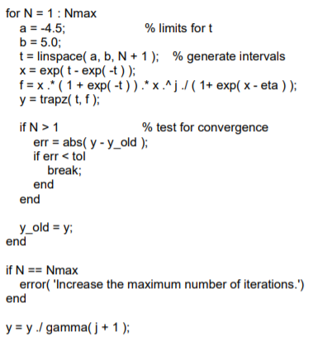
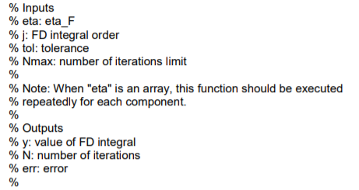
Simulation Using MATLAB

Slide 14
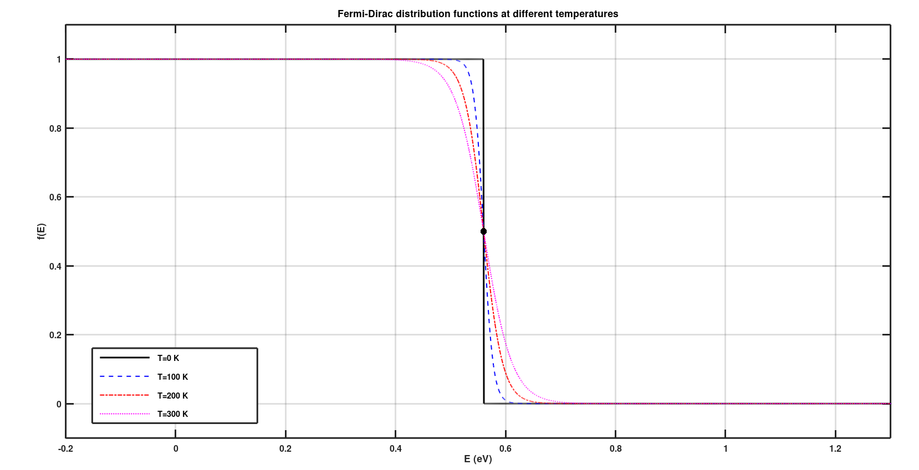
Generating Fermi Dirac Function Graph

Slide 15
Conclusion
From the above information finally, we can conclude that Macroscopic properties of a system can be computed using a Fermi-Dirac function. It is used to know Fermi energy at both zero and finite temperature cases.
In fields like electronics, one particular factor which is of prime importance is the conductivity of materials. This characteristic of the material is brought about the number of electrons which are free within the material to conduct electricity.
As per energy band theory, these are the number of electrons which constitute the conduction band of the material considered. Thus in order to have an idea over the conduction mechanism, it is necessary to know the concentration of the carriers in the conduction band.

Slide 16
THANK YOU!

